Slide 1
Voice over IP (VoIP)

Slide 2
Overview
Introduction
What is VoIP?
Applications
Underlying RFCs
Future Scope
Design and Implementation
Class Diagram
Libraries used
Client-Server Model
Protocol Definition
Testing and Validation
Roles of Team Members
Challenges Faced
Complexity of the RFC
Threading Models
Performance Issues
Other Problems

Slide 3
Introduction

Slide 4
What is VoIP
Voice over IP (VoIP) is the transmission of voice data over a network ^{[1]}
VoIP has evolved over time where earlier the people had to have a particular set in-order to converse using voice ^{[1]}

Slide 5
Applications of VoIP
Using VoIP has made international calling cheaper
VoIP can be used in an organization instead of buying separate lines from a teleco

Slide 6
Underlying RFCs
Real Time Transmission Protocol (RTP) ^{[1]}
Session Initiation Protocol (SIP) ^{[1]}
H.323 ^{[1]}

Slide 7
Future Scope
VoIP can be used in-order to uplift the rural or economically backward areas
VoIP is being improvised to accommodate conference calls
It also can provide a good platform for video conferencing

Slide 8
Design & Implementation

Slide 9
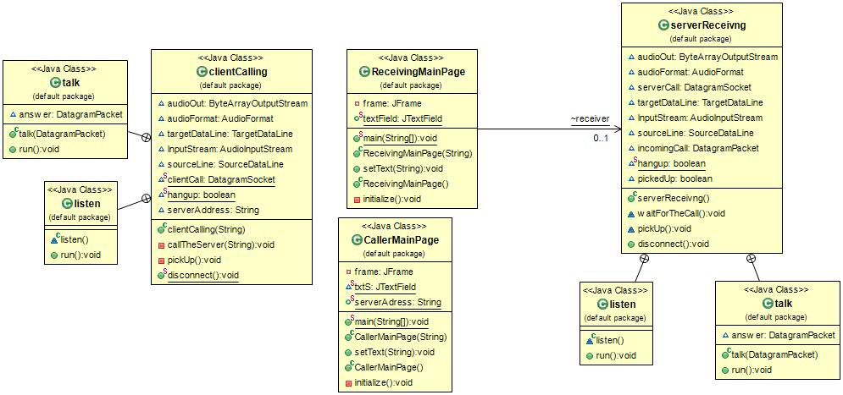
The UML Diagram

Slide 10
Classes Used
clientCalling
Talk
Listen
serverReceiving
Talk
Listen
CallerMainPage
ReceivingMainPage

Slide 11
Type of Approach
Considered as a client-server approach
Used UDP as connection type
Either of them can act as a server which is waiting to be contacted
Once, contacted the call is initiated and connection is maintained using SIP
The transmission of audio is done using RTP

Slide 12
The Protocols Used - SIP
The Session Initiation Protocol was developed by 3rd Generation Partnership Project (3GPP)^{[2]}
Session Initiation Protocol (SIP) is the backbone of VoIP
Used to setup and end connections
More details of SIP can be found in the defined RFC 3261

Slide 13
SIP- Working
SIP is a “request-response protocol”^{[2]}
Caller
Receiver
Send Call Request
Ringing
Accept Request
ACK
Session Established
End Connection
OK

Slide 14
SIP – Response codes
Some of the SIP response codes are:^{[4]}
100 trying
180 ringing
200 OK
401 not authorized
404 destination not found
486 busy

Slide 15
The Protocols Used - RTP
SIP is used to establish and end a connection, at the same time RTP is used to transmit media files over the network^{[2]}
RTP has another protocol working with it known Real Time Transmission Control Protocol (RTCP) which is used to maintain Quality of Service^{[3]}
The quality of service included handling problems like:
Loss ^{[3]}
Jitter ^{[3]}
Delay ^{[3]}
Echo ^{[3]}
More information about the RTP and RTCP can be found in RFCs 1889 and 3550

Slide 16
Testing and Validation
Tested stage by state
First stage: Recording Test (playback of recording sound on own system)
Second stage: Sending Test (playback at receiver end sent over localhost)
Third stage: Sending over Different Network (Sent to a different IP and checked one side transmission)
Fourth stage: Add threads on both ends to send and receive audio (send over different IP and tested)

Slide 17
Roles - Hema
Understanding of SIP and RTP
Developed the Threading Model
Implemented the call end feature
Recorded caller not answering feature
Documentation

Slide 18
Roles - Manan
Understanding of SIP and RTP
Implemented One Side Called (non-multithreading)
Developed the GUI
Documentation

Slide 19
Challenges Faced

Slide 20
Complexity of the RFC
Challenges face while implementing SIP and RTP for VoIP:
SIP
Line setup over a different IP
Setting up ports
RTP
Conversion of audio to bytes to be sent over the network
Re-conversion of bytes to audio
Jitter handling

Slide 21
Scalability
Our project is one to one calling
Further conference calls can be added

Slide 22
Threading Models
Two threads on each side
Tasks
Send Audio
Receive Audio

Slide 23
Performance Issues
Delay
Echo

Slide 24
Questions
Please feel free to ask questions!

Slide 25
References
[1] Rahul Singh, Ritu Chauhan, “International Journal of Enhanced Research in Management & Computer Applications”, Vol. 3 Issue 1, January 2014, pp: (15-23)
[2] Hassan Keshavarz, Mohammad Reza Jabbarpour Sattari, Rafidah Md Noor, “Session Initiation Protocol Attacks and Challenges”,2012 Internation Conference on Security Science and Technology, Hong-Kong, 10-12 March 2012
[3] Tommi Koistinen, “Protocol overview: RTP and RTCP”
[4] J. Rosenberg, H. Schulzrinne, G. Camarillo, A. Johnston, J. Peterson, R. Sparks, M. Handley, E. Schooler, “Session Initiation Protocol”, RFC: 3261

Slide 26
Thank You!

